Slide 1
ADC
Built in 10 bit ADC module- direct interface of analog inputs
Accommodate maximum 8 analog input
ADC function in successive approximation method
Does the conversion in 11 clock cycle
Resolution is 10 bit
Control registers are ADCON0, ADCON1
Converted outputs are stored in ADRESH ADRESL

Slide 2
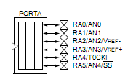
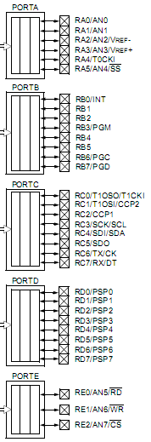

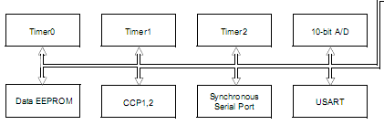

Slide 3
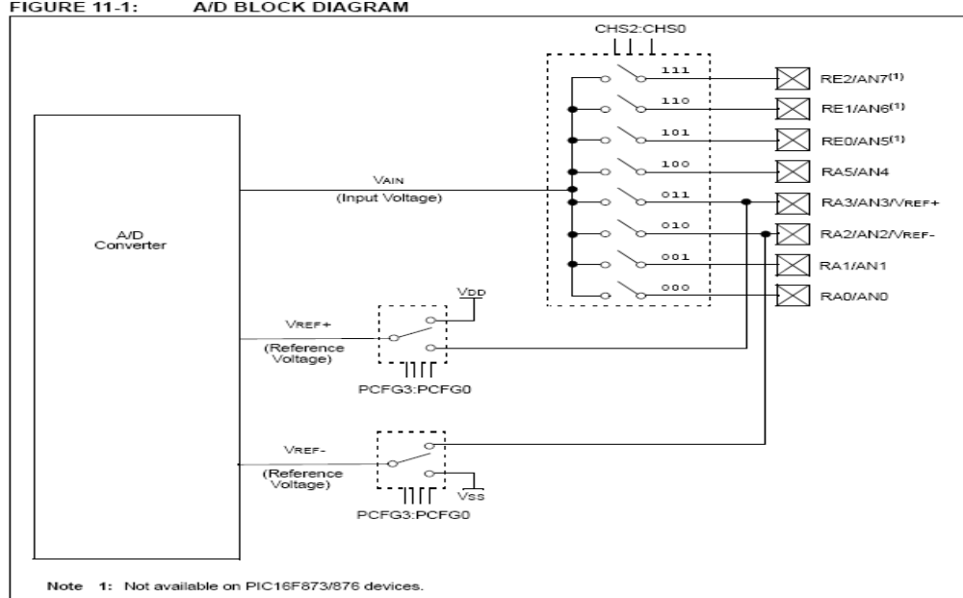
ADC module- Block

Slide 4
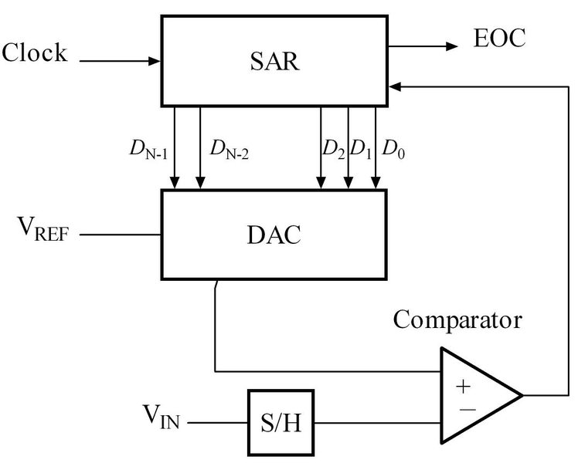
Successive approximation method

Slide 5
A/D has 4 main registers:
  ADCON0, : 1F : bank 0
  ADCON1 : 9F : bank 1
  ADRESH (A/D result high byte) : 1E : bank 0
  ADRESL (A/D result low byte) : 9E : bank 1

Slide 6
Analog signal charges a sample and hold capacitor
The converter generates a 10 bit digital value corresponding to the analog input.
The reference voltages for conversion are either VDD/VSS or given as external inputs through RA2/RA3
ADCON0 controls the operation of A/D converter
ADCON1 is used to set the port A/E pins to read analog inputs/reference
The converted digital output is written in to ADRESH and ADRESL registers.

Slide 7
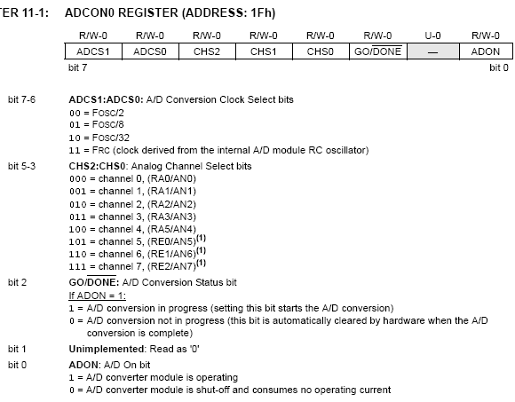

Slide 8
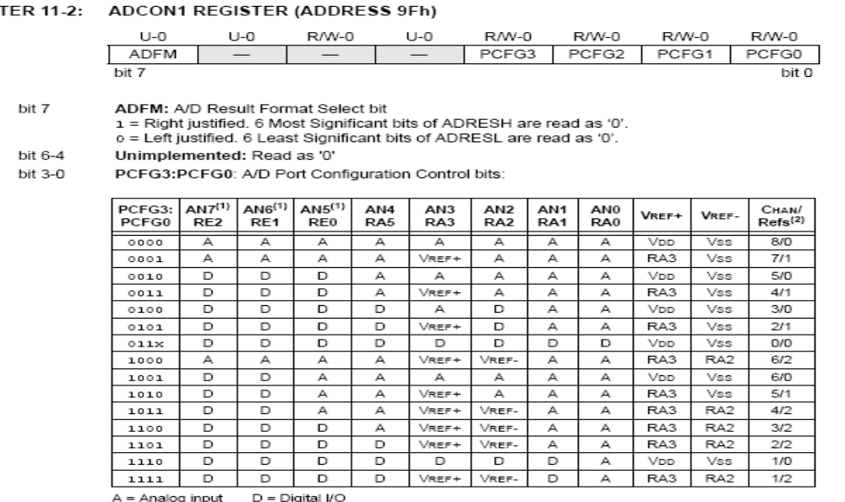

Slide 9
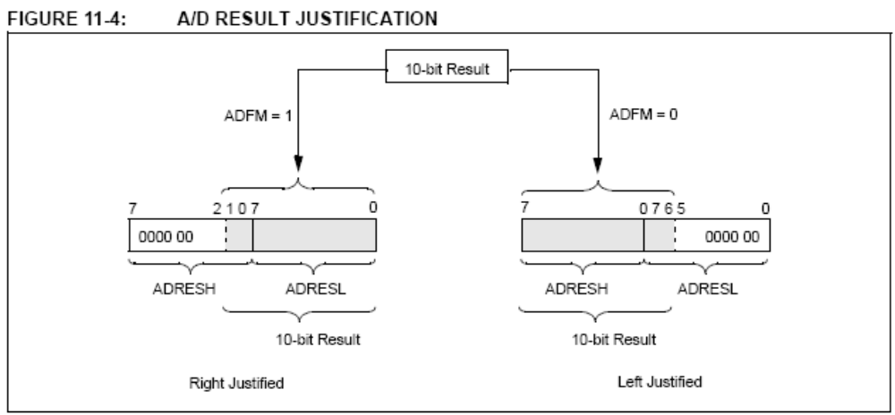

Slide 10
CONFIGURING A/D module
  1) Configure analog pins/ voltage reference/ and digital I/O (ADCON1)
  2) Select A/D input channel (ADCON0)
  3) Select A/D conversion clock (ADCON0).
  4) Turn on A/D module (‘ADON’ bit of ADCON0).
  If using Interrupt mode:
  clear ADIF bit
  Set GIE, PEIE and ADIE bits
  5) Wait the required acquisition time (time for capacitor to charge)

Slide 11
CONVERSION
  6) Start Conversion by setting GO/Done bit of ADCON0
  7) Check for completion :
  a: polling GO/Done bit or ADIF bit
  b: interrupt received
  8) Read A/D result register pair (ADRESH:ADRESL),
  9) Clear ADIF flag
  10) Wait for minimum 2TAD before repeating the process for the analog input.

Slide 12
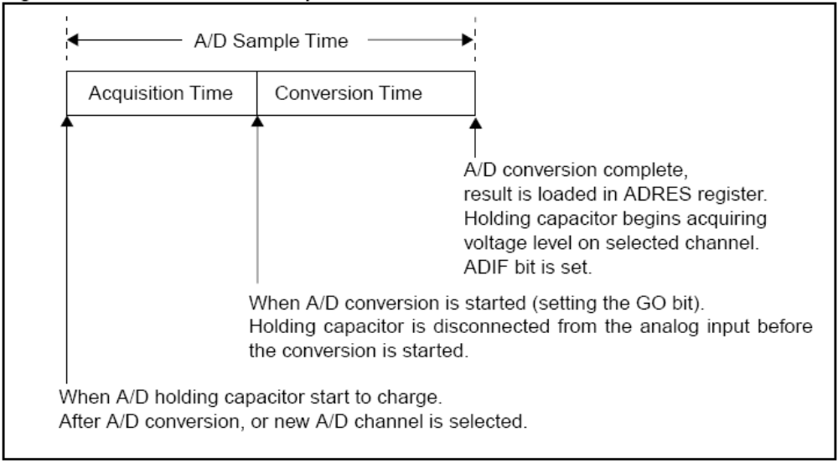

Slide 13
1) TAD = A/D conversion time per bit
2) Total conversion requires a minimum of 12 TAD.
3) Acquisition time:
Time required for the sample and hold capacitor to charge.
This much time (acquisition) is to be given after turning on the A/D before conversion can start.

Slide 14
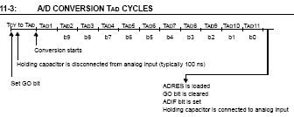
Before the ‘Set Go bit’, we need to wait for acquisition time.
After the Go bit, some time is used to disconnect the capacitor from analog input.

Slide 15
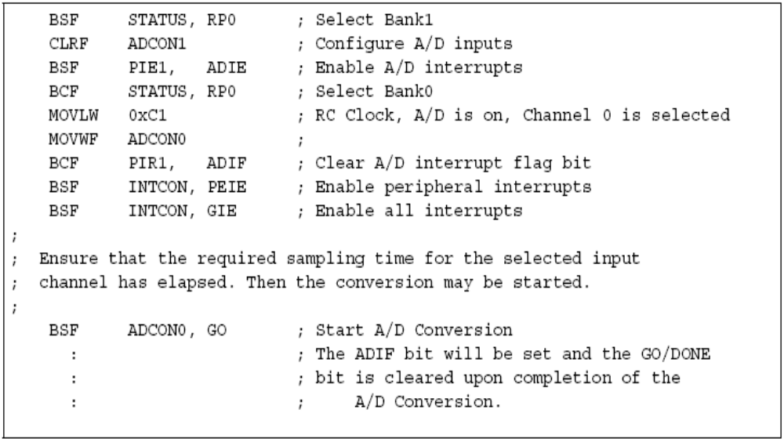
A/D conversion initialization For interrupt processing

Slide 16
Delay:
movlw 0xFF
movwf COUNT_1
movwf COUNT_2
movlw 0x05
movwf COUNT_3
delay_loop:
decfsz COUNT_1, F
goto delay_loop
decfsz COUNT_2, F
goto delay_loop
decfsz COUNT_3, F
goto delay_loop
return
ISR:
bcf STATUS, RP0
movf ADRESH, W
movwf PORTC
bsf STATUS, RP0
movf ADRESL,W
bcf STATUS,RP0
movwf PORTD
call Delay
retfie
Main:
bcf STATUS, RP0
bcf STATUS, RP1
CLRF PORTA
bsf STATUS, RP0
movlw 0x00
movwf ADCON1
movlw 0xff
movwf TRISA
BSF PIE1, ADIE
bcf STATUS, RP0
movlw 0xC1
movwf ADCON0
main_loop:
bcf PIR1,ADIF
bsf INTCON, PEIE
bsf INTCON, GIE
call Delay
bsf ADCON0, GO
movlw 0x00
bsf STATUS, RP0
movwf TRISC
movwf TRISD
bcf STATUS, RP0
goto main_loop
end

Slide 17
